Slide 1
Normalization
        Normalization is a process that “improves” a database design by generating relations that are of higher normal forms.
        The objective of normalization:
        “to create relations where every dependency is on the key, the whole key, and nothing but the key”.
91.2914

Slide 2
Normalization
There is a sequence to normal forms:
  1NF is considered the weakest,
  2NF is stronger than 1NF,
  3NF is stronger than 2NF, and
Also,
  any relation in 3NF is in 2NF; and
  any relation in 2NF is in 1NF.
91.2914

Slide 3
Normalization
1NF
a relation in BCNF, is also in 3NF
a relation in 3NF is also in 2NF
a relation in 2NF is also in 1NF
2NF
3NF
BCNF
91.2914

Slide 4
3.2 First Normal Form
Disallows
  composite attributes
  multivalued attributes
  nested relations; attributes whose values for an individual tuple are non-atomic
Considered to be part of the definition of relation
Slide 10- <number>

Slide 5

Figure 10.8 Normalization into 1NF
Dname | Dnumber | Dmgr_ssn
Dnumber | Dlocation
Slide 10- <number>

Slide 6
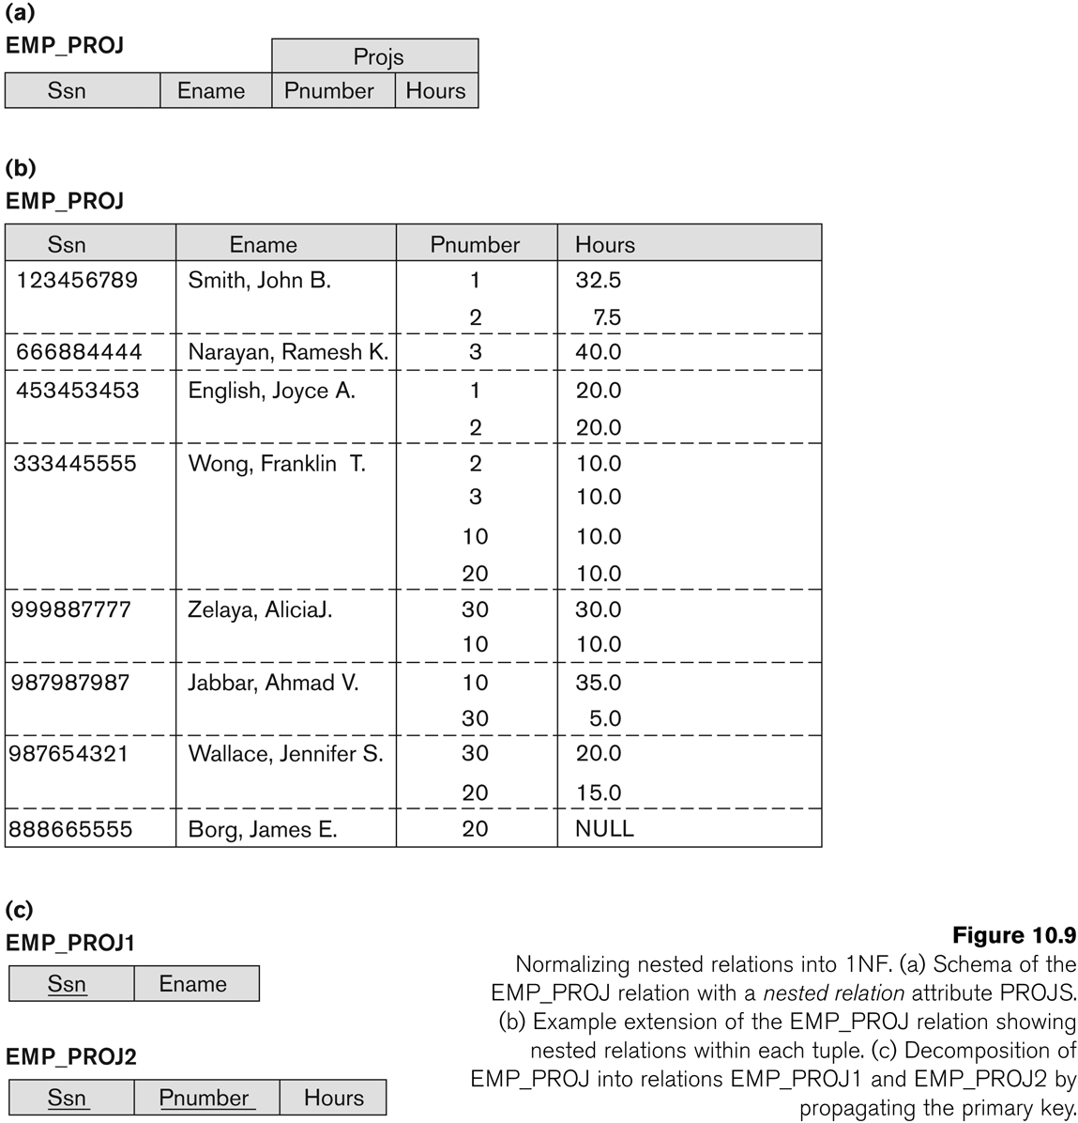
Figure 10.9 Normalization nested relations into 1NF
Slide 10- <number>

Slide 7
3.3 Second Normal Form (1)
Uses the concepts of FDs, primary key
Definitions
  Prime attribute: An attribute that is member of the primary key K
  Full functional dependency: a FD Y -> Z where removal of any attribute from Y means the FD does not hold any more
Examples:
  {SSN, PNUMBER} -> HOURS is a full FD since neither SSN -> HOURS nor PNUMBER -> HOURS hold
  {SSN, PNUMBER} -> ENAME is not a full FD (it is called a partial dependency ) since SSN -> ENAME also holds
Slide 10- <number>

Slide 8
Second Normal Form (2)
A relation schema R is in second normal form (2NF) if every non-prime attribute A in R is fully functionally dependent on the primary key
R can be decomposed into 2NF relations via the process of 2NF normalization
Slide 10- <number>

Slide 9
3.4 Third Normal Form (1)
Definition:
  Transitive functional dependency: a FD X -> Z that can be derived from two FDs X -> Y and Y -> Z
Examples:
  SSN -> DMGRSSN is a transitive FD
    Since SSN -> DNUMBER and DNUMBER -> DMGRSSN hold
  SSN -> ENAME is non-transitive
    Since there is no set of attributes X where SSN -> X and X -> ENAME
Slide 10- <number>

Slide 10
Third Normal Form (2)
A relation schema R is in third normal form (3NF) if it is in 2NF and no non-prime attribute A in R is transitively dependent on the primary key
R can be decomposed into 3NF relations via the process of 3NF normalization
NOTE:
  In X -> Y and Y -> Z, with X as the primary key, we consider this a problem only if Y is not a candidate key.
  When Y is a candidate key, there is no problem with the transitive dependency .
  E.g., Consider EMP (SSN, Emp#, Salary ).
    Here, SSN -> Emp# -> Salary and Emp# is a candidate key.
Slide 10- <number>

Slide 11
Fully Functional Dependency
FD1: InvNum,LineNum Qty, InvDate
If a non-key attribute depends on Prime key attribute then it is called as fully functional dependency.
InvNum
LineNum
Qty
InvDate
May 2012
91.2814

Slide 12
Transitive dependency
Transitive dependency
Consider attributes A, B, and C, and where
A → B and B → C.
Functional dependencies are transitive, which means that we also have the functional dependency A → C
We say that C is transitively dependent on A through B.
91.2914

Slide 13
Transitive dependency
EmpNum → DeptNum
EmpNum EmpEmail DeptNum DeptNname
DeptNum → DeptName
EmpNum EmpEmail DeptNum DeptNname
DeptName is transitively dependent on EmpNum via DeptNum
    EmpNum → DeptName
91.2914

Slide 14
Partial dependency
A partial dependency exists when an attribute B is functionally dependent on an attribute A, and A is a component of a multipart candidate key.
FD2: InvNum InvDate
InvNum
LineNum
Qty
InvDate
Candidate keys: {InvNum, LineNum} InvDate is partially dependent on {InvNum, LineNum} as InvNum is a determinant of InvDate and InvNum is part of a candidate key
91.2914

Slide 15
First Normal Form
First Normal Form
We say a relation is in 1NF if all values stored in the relation are single-valued and atomic.
1NF places restrictions on the structure of relations. Values must be simple.
91.2914

Slide 16
First Normal Form
The following in not in 1NF
EmpNum
EmpPhone
EmpDegrees
123
233-9876
333
233-1231
BA, BSc, PhD
679
233-1231
BSc, MSc
EmpDegrees is a multi-valued field:
  employee 679 has two degrees: BSc and MSc
  employee 333 has three degrees: BA, BSc, PhD
91.2914

Slide 17
First Normal Form
EmpNum
EmpPhone
EmpDegrees
123
233-9876
333
233-1231
BA, BSc, PhD
679
233-1231
BSc, MSc
To obtain 1NF relations we must, without loss of information, replace the above with two relations - see next slide
91.2914

Slide 18
First Normal Form
EmployeeDegree
Employee
EmpNum
EmpDegree
EmpNum
EmpPhone
333
BA
123
233-9876
333
BSc
333
233-1231
333
PhD
679
233-1231
679
BSc
679
MSc
An outer join between Employee and EmployeeDegree will produce the information we saw before
91.2914

Slide 19
Second Normal Form
Second Normal Form
A relation is in 2NF if it is in 1NF, and every non-key attribute is fully dependent on each candidate key. (That is, we don’t have any partial functional dependency.)
2NF (and 3NF) both involve the concepts of key and non-key attributes.
A key attribute is any attribute that is part of a key; any attribute that is not a key attribute, is a non-key attribute.
Relations that are not in BCNF have data redundancies
A relation in 2NF will not have any partial dependencies
91.2914

Slide 20
Second Normal Form
Consider this InvLine table (in 1NF):
InvNum
LineNum
ProdNum
Qty
InvDate
InvNum, LineNum
ProdNum, Qty
There are two candidate keys.
Qty is the only non-key attribute, and it is dependent on InvNum
InvNum
InvDate
InvLine is not 2NF since there is a partial dependency of InvDate on InvNum
InvLine is only in 1NF
91.2914

Slide 21
Second Normal Form
InvLine
InvNum
LineNum
ProdNum
Qty
InvDate
The above relation has redundancies: the invoice date is repeated on each invoice line.
We can improve the database by decomposing the relation into two relations:
InvNum
LineNum
ProdNum
Qty
InvNum
InvDate
Question: What is the highest normal form for these relations? 2NF? 3NF? BCNF?
91.2914

Slide 22
Is the following relation in 2NF?
inv_no
line_no
prod_no
prod_desc
qty
91.2914

Slide 23
2NF, but not in 3NF, nor in BCNF:
EmployeeDept
ename
ssn
bdate
address
dnumber
dname
since dnumber is not a candidate key and we have:
dnumber → dname.
91.2914

Slide 24
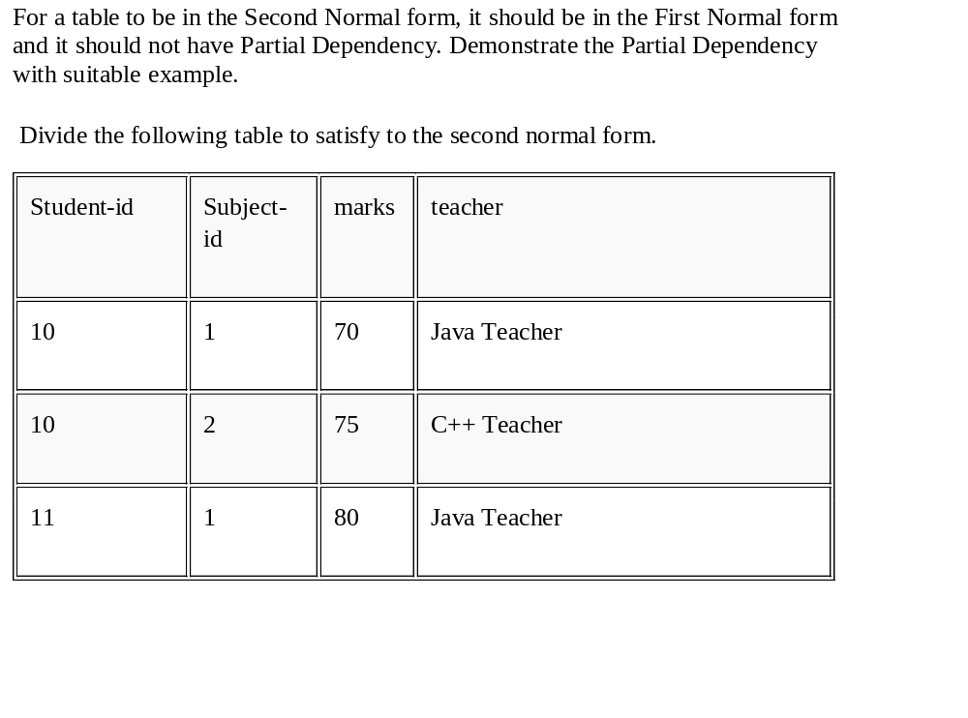
May 2012
91.2814

Slide 25
5. Multivalued Dependencies and Fourth Normal Form (1)
Definition:
A multivalued dependency (MVD) X —>> Y specified on relation schema R, where X and Y are both subsets of R, specifies the following constraint on any relation state r of R: If two tuples t₁ and t₂ exist in r such that t₁[X] = t₂[X], then two tuples t₃ and t₄ should also exist in r with the following properties, where we use Z to denote (R 2 (X υ Y)):
  t₃[X] = t₄[X] = t₁[X] = t₂[X].
  t₃[Y] = t₁[Y] and t₄[Y] = t₂[Y].
  t₃[Z] = t₂[Z] and t₄[Z] = t₁[Z].
An MVD X —>> Y in R is called a trivial MVD if (a) Y is a subset of X, or (b) X υ Y = R.
Slide 14-56

Slide 26
Multivalued Dependencies and Fourth Normal Form (3)
Definition:
A relation schema R is in 4NF with respect to a set of dependencies F (that includes functional dependencies and multivalued dependencies) if, for every nontrivial multivalued dependency X —>> Y in F⁺, X is a superkey for R.
  Note: F⁺ is the (complete) set of all dependencies (functional or multivalued) that will hold in every relation state r of R that satisfies F. It is also called the closure of F.
Slide 14-57

Slide 27
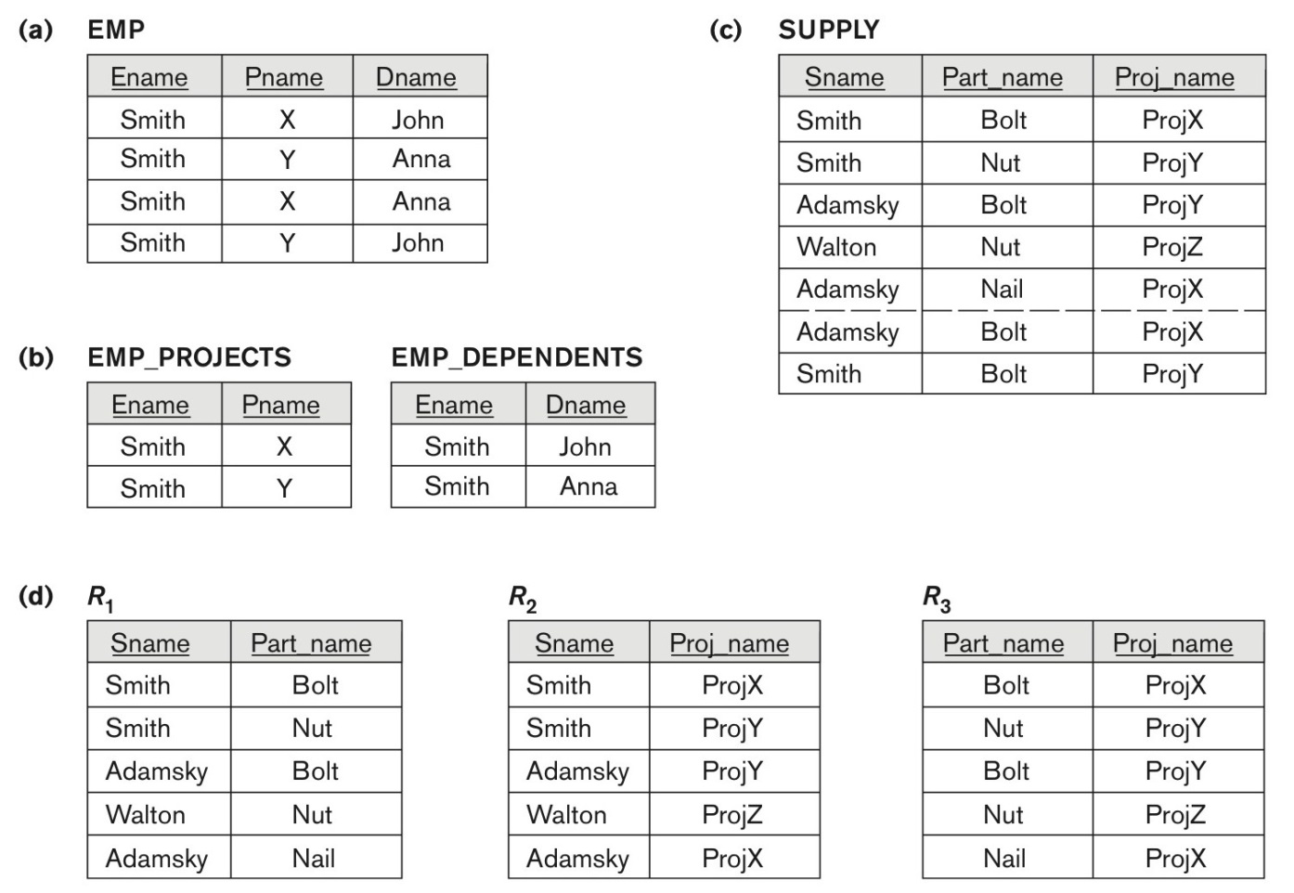
Figure 14.15 Fourth and fifth normal forms.
Figure 14.15
Fourth and fifth normal forms. (a) The EMP relation with two MVDs: Ename –>> Pname and Ename –>> Dname. (b) Decomposing the EMP relation into two 4NF relations EMP_PROJECTS and EMP_DEPENDENTS. (c) The relation SUPPLY with no MVDs is in 4NF but not in 5NF if it has the JD(R1, R2, R3). (d) Decomposing the relation SUPPLY into the 5NF relations R1, R2, R3.
Slide 14- <number>

Slide 28
6. Join Dependencies and Fifth Normal Form (1)
Definition:
A join dependency (JD), denoted by JD(R₁, R₂, ..., R_{n}), specified on relation schema R, specifies a constraint on the states r of R.
  The constraint states that every legal state r of R should have a non-additive join decomposition into R₁, R₂, ..., R_{n}; that is, for every such r we have
  * (π_{R1}(r), π_{R2}(r), ..., π_{Rn}(r)) = r
Note: an MVD is a special case of a JD where n = 2.
A join dependency JD(R₁, R₂, ..., R_{n}), specified on relation schema R, is a trivial JD if one of the relation schemas R_{i} in JD(R₁, R₂, ..., R_{n}) is equal to R.
Slide 14- <number>

Slide 29
Join Dependencies and Fifth Normal Form (2)
Definition:
A relation schema R is in fifth normal form (5NF) (or Project-Join Normal Form (PJNF)) with respect to a set F of functional, multivalued, and join dependencies if,
  for every nontrivial join dependency JD(R₁, R₂, ..., R_{n}) in F⁺ (that is, implied by F),
    every R_{i} is a superkey of R.
Discovering join dependencies in practical databases with hundreds of relations is next to impossible. Therefore, 5NF is rarely used in practice.
Slide 14- <number>

